Slide 1
Lesson 2 - Timers

Slide 2
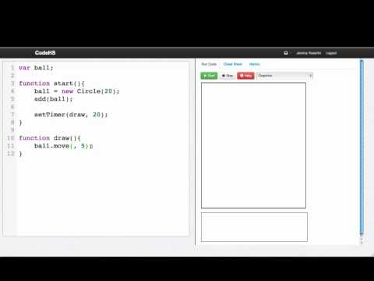

Slide 3
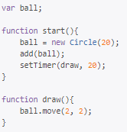
When will the function draw be called?
Once, inside of start
Never
Every 20 milliseconds
Every 20 seconds

Slide 4
Which statement will call a function animate every 50 milliseconds?
setTimer(animate, 50);
setTimer(animate(), 50);
for(var i = 0; i < 50; i++){
animate();
}
timer.animate(50);

Slide 5
Example: Moving Ball
var ball;
function start(){
ball = new Circle(20);
add(ball);
setTimer(draw, 20);
}
function draw(){
ball.move(2, 2);
}

Slide 6
Example: Magic 8 Ball
This is an example for this lesson. You are encouraged to play around with it, run and change the code, and learn how it works. When you are done, click continue to go to the next problem.

Slide 7
Exercise 3.2.1: Crazy Ball
Program Result
Write a program that users timers to simulate a “crazy” ball. What this means is that every 100 milliseconds, the ball should change its position to a random location on the screen. Each time that you change the position of the ball you should also set its color to be a random color. Make sure the entire ball is visible on the screen at each random position.
You should use a timer and the Randomizer to make this work.

